Slide 1
E V E N T
P L A N N I N G
S P R I N T
WORKBOOK
Note! This workbook copy is delivered exclusively to AJK students and is copyright protected. Please do not share. © Event Entrepreneur & Event Planning Sprint

Slide 2
1 KNOW YOUR
STEP 1
AUDIENCE
To inspire change and emotional shift in someone, you have to know who they are and what they care about.
STEP PROGRESS: EVENT AND AUDIENCE PROFILE
EVENT NAME AND TYPE
EVENT DURATION
AUDIENCE PROFILE
AUDIENCE EXPECTATIONS
AUDIENCE FEELINGS
PEAK 1
PEAK 2
PEAK 3
Gather all the essential information
you need to know about your event and audience before you start to plan your event.
Touch- point
Touch- point
Touch- point
Touch- point
Touch- point
Touch- point
Touch- point
Touch- point
Touch- point
Touch- point
Content ideas
Content ideas
Content ideas
Content ideas
Content ideas
Content ideas
Content ideas
Content ideas
Content ideas
Content ideas
Consider the following:
What experience do you want to design? Who might attend?
How long is this experience? Who are they to one another? Why are they there?
What do you want them to feel and not to feel?
AC T I O N :
Step duration max. 20 min.
Use the template on the next page to gather your insights
Craft this step in the Event Plan Draft -template at the end of the workbook

Slide 3
1 KNOW YOUR AUDIENCE
STEP 1
Template
What type of experience do you want to
Who might attend? Gender %, age range, expertise? Get specific!
How long is this experience? 30 min / 2 days / a month? Not yet determined?
design? Seminar, product launch, wedding?
Who are they to one another?
Power dynamics, relationships, history?
Why are they there? Expectations, motivations, incoming needs?
What do you want them to feel? Desired and undesired feelings, emotional shifts?

Slide 4
2 DESIGN
STEP 2
TOUCHPOINTS
STEP PROGRESS: TOUCHPOINTS AND CONTENT IDEAS
EVENT NAME AND TYPE
EVENT DURATION
AUDIENCE PROFILE
AUDIENCE EXPECTATIONS
AUDIENCE FEELINGS
Design an event experience with touchpoints that create desired feelings.
PEAK 1
PEAK 2
PEAK 3
Touchpoints are the points of interaction between the event audience and your event experience.
Touch- point
Touch- point
Touch- point
Touch- point
Touch- point
Touch- point
Touch- point
Touch- point
Touch- point
Touch- point
Content ideas
Content ideas
Content ideas
Content ideas
Content ideas
Content ideas
Content ideas
Content ideas
Content ideas
Content ideas
They include everything from hearing about the event, getting registered to experiencing the keynotes and filling out the satisfaction survey.
AC T I O N :
Step duration max. 40 min.
Throw all possible interaction ideas into the play!
Craft this step in the Event Plan Draft -template at the end of the workbook

Slide 5
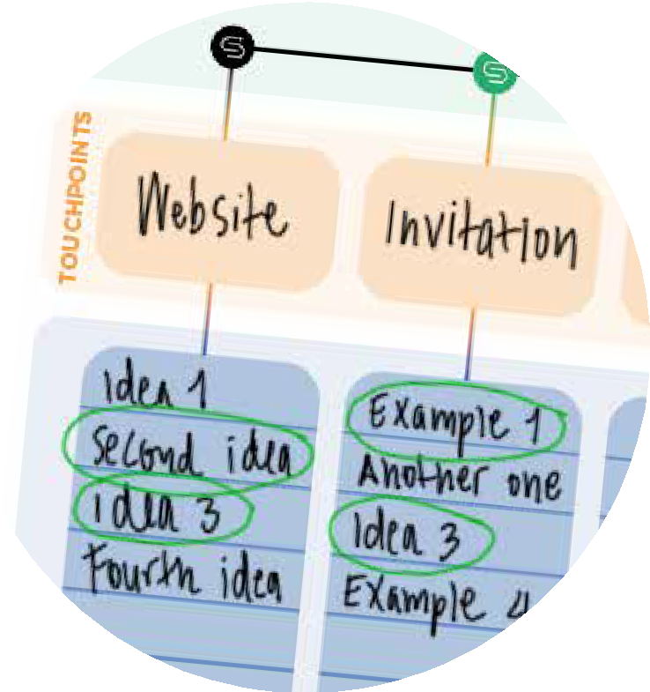
3 SELECT THE
STEP 3
STICKIEST IDEAS
STEP PROGRESS: CONTENT IDEAS
EVENT NAME AND TYPE
EVENT DURATION
AUDIENCE PROFILE
AUDIENCE EXPECTATIONS
AUDIENCE FEELINGS
How sticky is your idea? Evaluate your ideas using these principles. “Sticky” ideas include at least three principles.
PEAK 1
PEAK 2
PEAK 3
SIMPLE
Easy to understand and share
Breaks the script and grabs your attention
Easy to remember and picture in your head
Believable and something you want to try
So authentic that it makes people feel and care
Relates, motivates and inspires to act
Touch- point
Touch- point
Touch- point
Touch- point
Touch- point
Touch- point
Touch- point
Touch- point
Touch- point
Touch- point
Content ideas
Content ideas
Content ideas
Content ideas
Content ideas
Content ideas
Content ideas
Content ideas
Content ideas
Content ideas
UNEXPECTED
CONCRETE
CREDIBLE
EMOTIONAL
STORY
AC T I O N :
Step duration max. 20 min.
Evaluate the stickiness of your content ideas and mark the ones that meet the criteria
Craft this step in the Event Plan Draft -template at the end of the workbook

Slide 6
4 IDENTIFY MOMENTS
STEP 4
THAT MATTER
Identify the key moments that matter the most in your event experience.
STEP PROGRESS: PEAK MOMENTS
EVENT NAME AND TYPE
EVENT DURATION
AUDIENCE PROFILE
AUDIENCE EXPECTATIONS
AUDIENCE FEELINGS
PEAK 1
PEAK 2
PEAK 3
What are the emotional peaks of your experience? People tend to remember the standout moments, both good and bad, and the ending of an experience.
Think about how might you close the loop? How can you honor what has been accomplished together or celebrate a transformation?
Touch- point
Touch- point
Touch- point
Touch- point
Touch- point
Touch- point
Touch- point
Touch- point
Touch- point
Touch- point
Content ideas
Content ideas
Content ideas
Content ideas
Content ideas
Content ideas
Content ideas
Content ideas
Content ideas
Content ideas
THE OPENING
THE MIDDLE PEAK
THE CLOSING
AC T I O N :
Step duration max. 20 min.
Identify the peak moments of your event
Craft this step in the Event Plan Draft -template at the end of the workbook

Slide 7
5 BUILD AN EVENT
STEP 5
PLAN FOR YOUR CLIENT
By now, you should have an outline for what could happen in your event experience drafted to the Event Plan Draft -template.
Review your event plan draft before creating the final version for your client. Make sure you have:
Engaged the target audience and the desired feelings
All relevant event touchpoints in place
STEP PROGRESS: BUILD YOUR FINAL EVENT
EVENT NAME AND TYPE
EVENT DURATION
AUDIENCE PROFILE
AUDIENCE EXPECTATIONS
AUDIENCE FEELINGS
PEAK 1
PEAK 2
PEAK 3
Touch- Touch-
point point
Touch- point
Touch- point
Touch- point
Touch- point
Touch- point
Touch- point
Touch- point
Touch- point
Content Content
ideas ideas
Content ideas
Content ideas
Content ideas
Content ideas
Content ideas
Content ideas
Content ideas
Content ideas
Evaluated the stickiness of your content ideas and marked the ones with the highest relevance and impact
Found 2-3 peak moments that could cause emotional breakthroughs in your audience?
AC T I O N :
Step duration max. 20 min.
- Create the final plan ready to be sent to your client by using the Event Plan -template

Slide 8
EVENT PLAN DRAFT
EVENT PLAN DRAFT
EVENT PLAN DRAFT
EVENT PLAN DRAFT
EVENT NAME AND TYPE
EVENT DURATION
AUDIENCE PROFILE
AUDIENCE EXPECTATIONS
EVENT SUCCESS RELIES ON AUDIENCE FEELING THIS
PEAK MOMENTS
TOUCHPOINTS
CONTENT IDEAS

Slide 9
EVENT PLAN
EVENT NAME AND TYPE
EVENT DURATION
AUDIENCE PROFILE
AUDIENCE EXPECTATIONS
EVENT SUCCESS RELIES ON AUDIENCE FEELING THIS
PEAK MOMENTS
TOUCHPOINTS
CONTENT IDEAS

